Slide 1


Slide 2

TABLE OF CONTENTS
Overview
01
Problem Statement
02
Objectives
03
Key Insights / Report
04
Conclusion & Recommendations
05

Slide 3






Overview
This report analyzes employee attrition patterns using demographic, compensation, and work-related factors. The aim is to identify key trends influencing employee turnover and provide data-backed recommendations to improve retention.

Slide 4


Problem Statement
Impacts of Employee attrition:
Productivity Impact
Disrupts workflow, team output and institutional knowledge
Cost Increases
Higher recruitment and training expenses
Morale Effects
Remaining team members experience uncertainty
Identifying which factors contribute most to employee turnover is crucial for developing proactive strategies.

Slide 5
Objectives
01
To quantify and profile attrition across organizational demographics and functions.
02
To identify high-risk employee segments contributing to workforce turnover.
03
To explore root causes of attrition using satisfaction, education, and tenure metrics.
04
To provide actionable recommendations to improve employee retention and organizational stability.

Slide 6
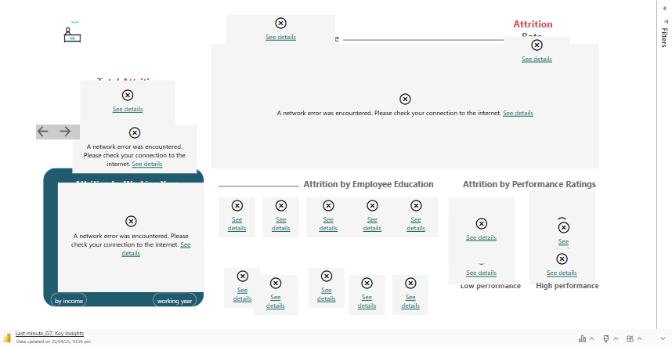
Key Insights

Slide 7

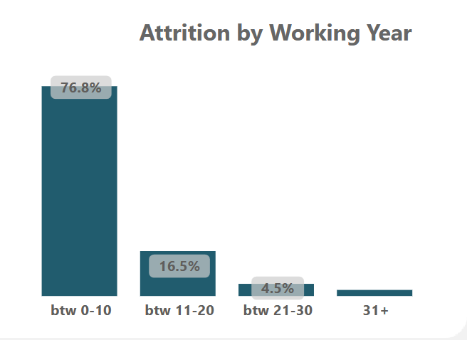
Recommendations
Reduce early-career attrition by 30% by Q2 2026.
Implement a structured 6-month onboarding and mentorship program for employees with <3 years of tenure and performance ratings above 3.
Track 6-month retention rate and engagement survey scores post-onboarding.

Slide 8

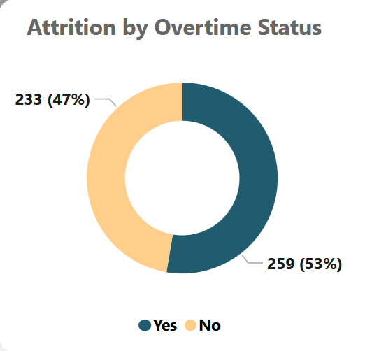
Recommendations
Lower attrition in high-overtime groups by 25% and reduce attrition among high-performing employees by 20% within 12 months.
Enforce a maximum of 10 hours/week overtime for roles in Field and Customer Operations.
Introduce career development, competitive pay, flexible work, and recognition to reduce high-performer attrition by 20% within 12 months.
Attrition rate segmented by overtime/commute status

Slide 9
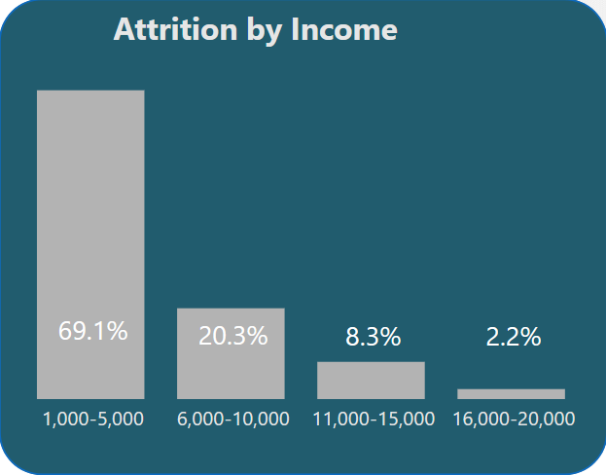
Recommendations
Improve retention in low-income roles by 35% and reduce external
job migration.
Increase base salary by up to 50% over two years for employees earning between GHS 1,000 – GHS 5,000.
Pre/post attrition comparison in low-income group and satisfaction score improvement

Slide 10
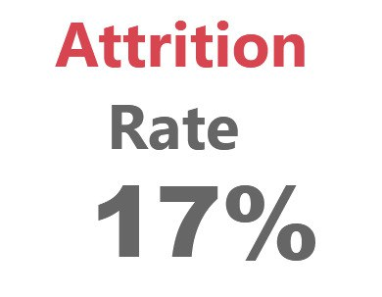
Recommendations
Measure and Improve Workflow & Onboarding Disruption
Introduce a Workflow Disruption Index (WDI) calculated as % of tasks delayed due to unfilled roles or turnover.
Deploy a 90-day New Hire Productivity Score, based on onboarding completion rate and KPI achievement.
Weekly workflow KPIs

Slide 11
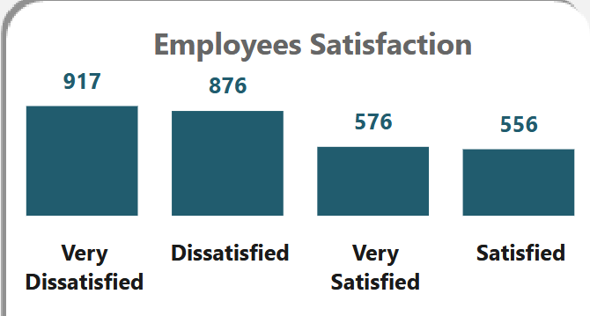
Recommendations
Improve Employee Satisfaction Monitoring
Increase “Satisfied” and “Very Satisfied” employee percentage from 40.3% to 70% by Q3 2025
Launch monthly pulse surveys focused on recognition, workload, and development.
Require managers to respond to low scores within 7 days with action plans.
Monthly satisfaction dashboard with trendline tracking, Regular surveys and exit interviews
32.6%
31.2%
20.5%
19.8%

Slide 12
Conclusion
PharmNova’s attrition trends suggest the need for focused HR interventions to address turnover, particularly in research, manufacturing, and technical roles. By investing in employee experience, career development, and work-life balance initiatives, PharmNova Inc. can enhance retention, reduce attrition, and foster a loyal, engaged workforce in the highly competitive pharmaceutical industry.

Slide 13











Thank You
Team Members
Emmanuel Adjei
Benedicta Esenam Deke
Christabel Ogbemi
Daniel Cobbinah Afful,
ProM, MCIMG.
Emmanuel J. Koomson
Blossom Academy Data
Analytics Fellow
Blossom Academy Data
Analytics Fellow
Blossom Academy Data
Analytics Fellow
Blossom Academy Data
Analytics Fellow
Blossom Academy Data
Analytics Fellow

